Slide 1
Networking and distributed applications
INFDEV04-5

Slide 2
Motivation…
Implementing reliable software can be a difficult process, why?
Notes:
- How are applications that run locally setup? Code, files and database are on the same machine
- Such a process is usually separated into phases to improve detecting errors for each implemented components
- Beside errors that are produces by programming the software itself others could be made through configuring or programming the network and infrastructure
- In order to detect errors correctly additional knowledge about networking and Infrastructure is needed.

Slide 3
Motivation
Recent development of web applications and the infrastructure around it has implication on the design and the implementation of software
With recent development we mean cloud computing:
Software as a service SaaS (for example web shops)
Platform as a service PaaS (for example a servers)
Infrastructure as a service IaaS (for example hardware)

Slide 4
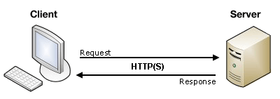
Client server architecture
The architecture we are using is a client server architecture
A server node runs one or more server programs which share their resources with clients
A client node does not share any of its resources, but requests a server's content or service function
Notes:
A distributed application structure is a partition of the tasks or workloads between servers, and service requesters, called clients

Slide 5
Client server architecture…
Client and server communication is implemented using network protocols.
What is the function of a protocol?
Notes:
Your application must respect the specification of the used protocols.
An example of such used protocols are IP, TCP, UPD, HTTP
We will look closer to some protocols in the following slides.
Syntax (data format and coding)
Semantics (control information and error handling)
Timing (speed matching and sequencing)

Slide 6
Client server architecture
Demo (run the app)

Slide 7
Networking
What is a computer network or data network?
How are data transmitted in the network?
Layers are characterized through their organizational purpose:
Local area network (LAN) which is usually limited to a building
Wide area network (WAN) which extends over a large geographical distance
Virtual Private network (VPN) which uses tunneling to connect to another network
Notes:
Computer network is a telecommunications network which allows computers to exchange data
Data are transmitted as a bit of streams or as a network packet that is a formatted unit of data (a list of bits or bytes)

Slide 8
Network topologies
A network topologie is a graph structure used to connect/link different nodes to create a network
Nodes could be any hardware components such as hosts, switches, servers, routers, printers etc) that are connected/linked
Every topology shown above has it’s own dis-/advantages
For example in a star topology the fail of the central node breaks the connection completely
Data in the network are transmitted through one or the combination of different topologies

Slide 9
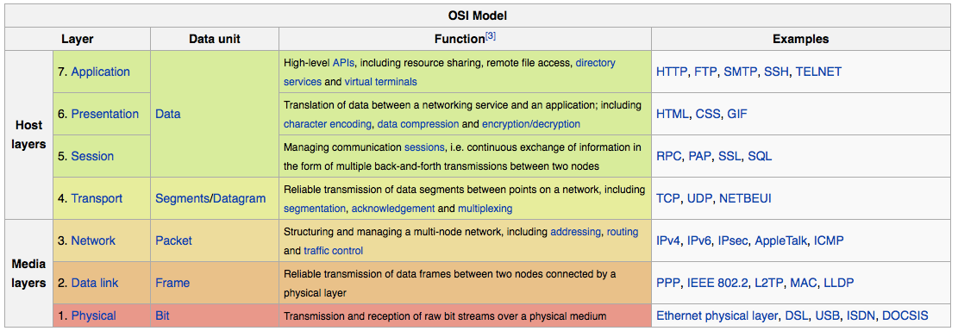
OSI model
Open Systems Interconnection model (OSI model)
It is a conceptual model that characterizes and standardizes the communication of a telecommunication or computing system
Consist of 7 layers, each layer adds more information to the header of the package that is been sent from a host to another one

Slide 10
Common network layers and data flow
Let us look at a typical example of making a a voice over ip (voip call)
Notes:
A voip call uses typically a UDP connection.
The data flows in the networks starting from host one (A) until it reaches host (B)
It might flow through some routers between host (A) and (B)

Slide 11
Internet protocol
IP has the task of delivering packets from the source node to the destination node
How is this delivery established?
Why do we need such a protocol?
There are two versions of it?
IPv4
Since 1981
32 bit
Decimal / 4 groups of 3 digits
Notes:
Delivery established through IP address
IP also defines addressing methods that are used to label the datagram with source and destination information

Slide 12
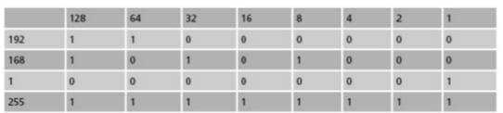
IPv4 sample
Consider having the following private IP address for a machine:
192.168.1.255
The IP address is represented through the following binary code
11000000.10101000.00000001.11111111

Slide 13
Subnet mask
To match physical layout (e.g. Sales, production, etc.)
To match administrative layout (e.g. Managers, staff, etc.)
To plan for growth
To reduce network traffic
Examples
A 255.0.0.0 first byte is fixed
B 255.255.0.0 first two bytes are fixed
C 255.255.255.0 first three bytes are fixed
Subnets are used to determine the address is local or remote

Slide 14
IPv6
128 bit (as mac-addresses of machines)
Hexadecimal (base 16 or hex)
Not interoperable with IPv4
Improves some limitation of IPv4 such as:
Exhausting IPv4 addresses
improve IPv4 routing through changing the package structure
The packet header in IPv6 is simpler than the IPv4 header. Many rarely used fields have been moved to optional header extension
Example FE80:0000:0000:0000:0202:B3FF:FE1E:8329

Slide 15
Code example
Demo a server and client communication

Slide 16
Transport layer protocols UPD vs TCP
User datagram protocol(UDP)
It uses a simple connectionless transmission.
It has no handshaking dialogues
Transmission control protocol(TCP)
It sends the byte stream in a reliable, ordered way
It has an error-checking mechanism of sending packages
Example of usage within application:
UDP: video or audio streaming
TCP: FTP file transfer or HTTP connections

Slide 17
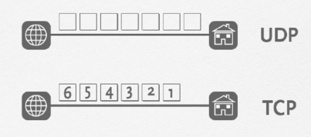
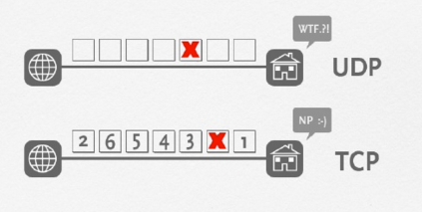
TCP vs. UDP

Slide 18
Web applications
How does a web application work?
What are the basic ingredients of a web application?
In addition to IP/TCP or IP/UDP it uses HTTP (Hypertext Transfer Protocol)
Component files
Code files: Websites are built primarily from HTML, CSS, and JavaScript
Assets/Resources: This is a collective name for all the other stuff that makes up a website
Database
Notes:
HTTP is an application protocol that defines a language for clients and servers to speak to each other. This is like the language you use to order your goods.
:A website is made up of many different files, which are like the different parts of the goods you buy from the shop. These files come in two main types: Code files, Assets
Assets: such as images, music, video, Word documents, and PDFs.

Slide 19
Web application
Demo postman

Slide 20
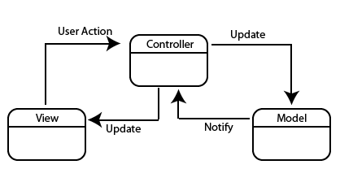
Model-View-Controller (MVC)
It is a architectural design pattern.
What is the purpose of MVC design pattern?
Intent: Partition an applications into three parts
Model
View
Controller
Notes:
Motivation: Use divide and conquer to simplify among the parts of a program
- Defines the role the objects play in an application into one of three parts
- Defines the way objects communicate with each other

